Slide 1

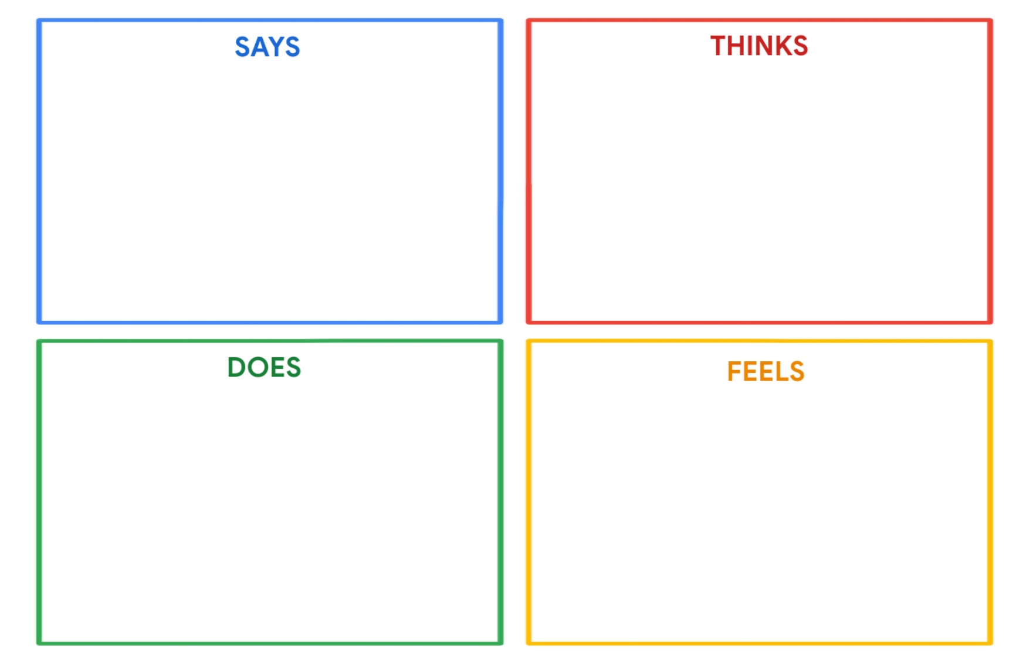
Tariq Farid
"Sports are my passion, and I put a lot of effort into my athletic pursuits."
"I aim to boost my mental skills through programming."
"I want to create fun movies using code."
"I wish I could learn programming independently."
"Sports bring me joy and help me stay physically fit."
"Programming can enhance my mental skills and problem-solving abilities."
"Creating fun movies with code could be an exciting creative outlet."
"I find complex programming concepts daunting but am eager to learn."
His baby sister's presence brings him joy and a sense of responsibility.
He is excited about the programming to enhance his mental skills.
The idea of creating fun movies with code brings a sense of creative
Complex programming concepts may be intimidating.
Tariq actively trains and participates in sports to be a professional athlete.
He spends time with his baby sister, nurturing their relationship.
He seeks programming activities to enhance his mental skills.
He explores opportunities for independent learning, where possible

